Slide 1
Magazine cover

Slide 2
Progression

Slide 3
Comparisons to other covers

Slide 4
Photo Editing

Slide 5
Photo Editing

Slide 6
Photo Editing

Slide 7
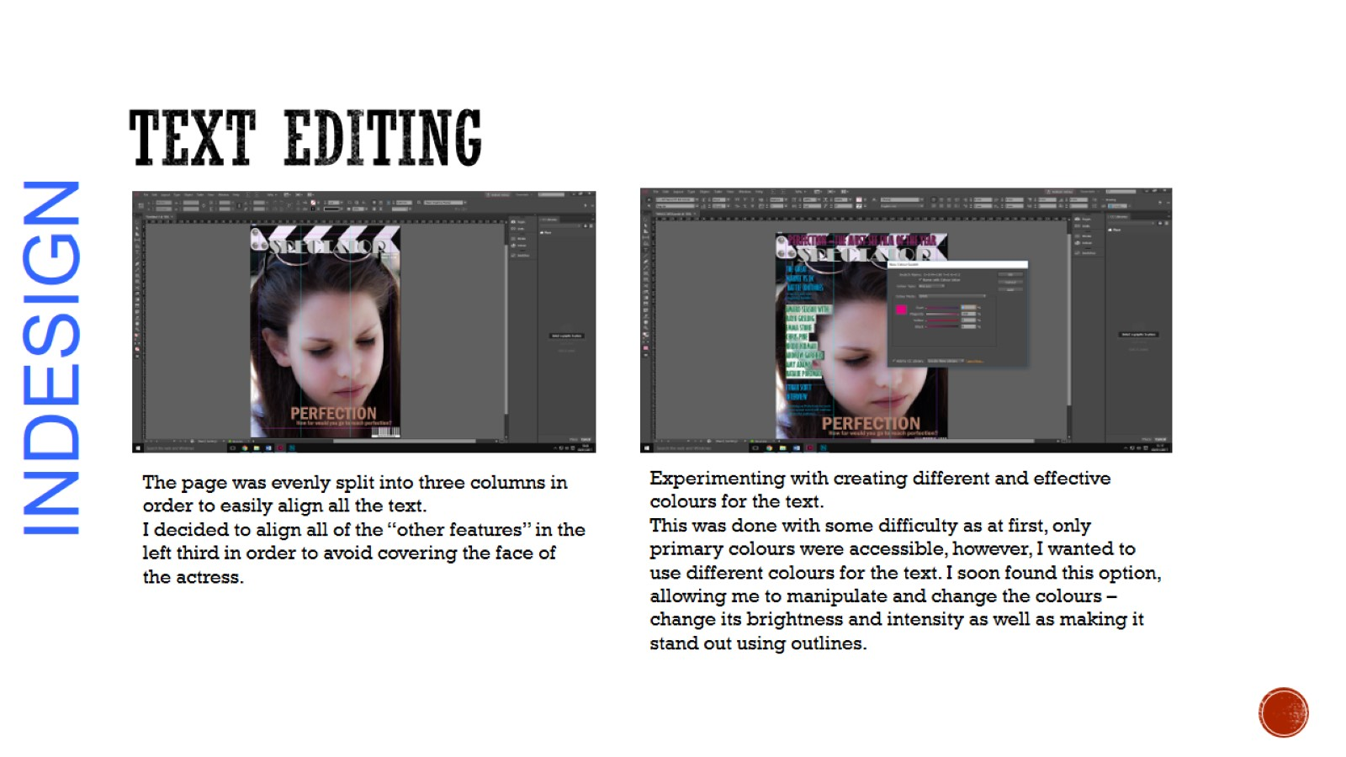
TEXT EDITING

